Slide 1
Project Training II
User story
MAITRE Robin, VAILLANT Yann, GALAN Guillaume, OHLAND Emmanuel, CAO Yuguo,

Slide 2
Summary
Customer story cards
Restaurant story cards
System Architecture

Slide 3
Customer story cards
Story card Title : Plan the meal Estimate : 1 day Priority : 1
User Story: As a customer, I want to have a meal with some relatives and I want to send an online invitation.
Acceptance test criteria : Communication with the backend (HTTP, JSON) Create a form and send it Send a invitation to contacts Receive confirmation
Note : Create a form and send it. Receive confirmations and invitations.

Slide 4
Customer story cards
Story card Title : Online reservation Estimate : 2 day Priority : 1
User Story: As a customer, I want to make a reservation and order my meal online.
Acceptance test criteria : Communication with the backend (HTTP, JSON) Create a form Send reservation and meal order
Note : Create a form and send it.

Slide 5
Customer story cards
Story card Title : Offline reservation Estimate : 2 day Priority : 1
User Story: As a customer, I want to make a reservation and order my meal Offline when I’m already at the restaurant
Acceptance test criteria : NFC to peering to the restaurant network Create a form (same as online with presetting) Send reservation and meal order Communication with the backend (HTTP, JSON)
Note : NFC for peering, create a form and send it.

Slide 6
Customer story cards
Story card Title : Line up off line Estimate : 1 day Priority : 1
User Story: As a customer, I would like know when my table is ready and I don’t want to wait, I would like do something else.
Acceptance test criteria : NFC communication Send confirmation to server
Note : NFC tag authentication

Slide 7
Customer story cards
Story card Title : Settings Estimate : 1 day if enough time left Priority : 3
User Story: The user can set some of parameters like if they are kids, spicy food… And generals settings for the application.
Acceptance test criteria : Set parameters for the application Set parameters for orders
Note : Settings for the application and different filters for researches

Slide 8
Customer story cards
Story card Title : Push service Estimate : 1 day Priority : 2
User Story: As an customer, I would like to know when my table is ready
Acceptance test criteria : Receive a push
Note : Use google service for push notification

Slide 9
Restaurant story cards
Story card Title : Manage seat and meal reservation Estimate : 1 day Priority : 1
User Story: As a restaurant manager I would like know how many seat is free and choose which table will be great for the customer. I would like take the customer order too.
Acceptance test criteria : Confirm / cancel / update seat Confirm / cancel / update meal
Note : Manage seat and manage meal

Slide 10
Restaurant story cards
Story card Title : Manage the line up Estimate : 1 day Priority : 1
User Story: As a restaurant manager I would like say to my customers when theirs table are ready.
Acceptance test criteria : Send a push to the correct customer
Note : Google service

Slide 11
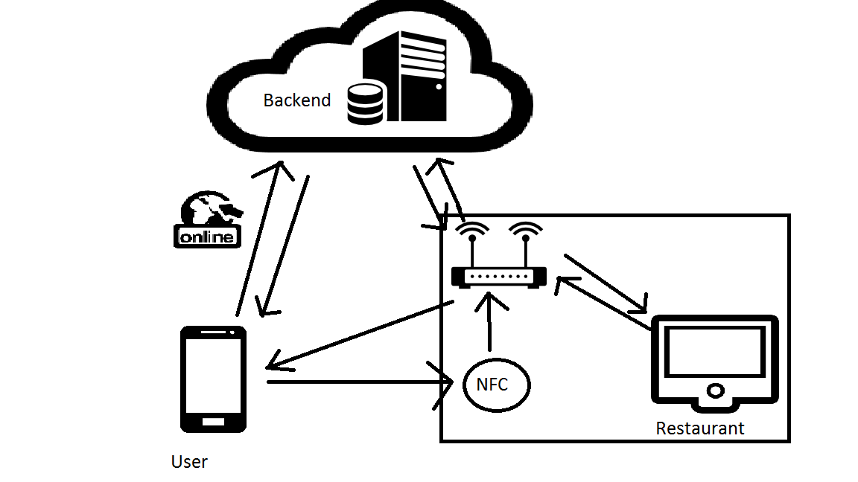
System Architecture

